Slide 1
The supported housing sector’s impact on homelessness prevention and health and wellbeing
Research summary

Slide 2
What is supported housing?
Supported housing is accommodation where residents receive support, supervision or care.
Supported housing services range widely, but they all play a crucial role in providing a safe and secure home with support for people to live independently.
Some supported housing services are short term and used to prepare people to move on to live on their own eventually. Other services support people in the longer term over many years.
Supported housing provides accommodation and support for many people including:
  Disabled people.
  Homeless people.
  Survivors of domestic violence.
  People experiencing mental health problems.
  And many more.

Slide 3
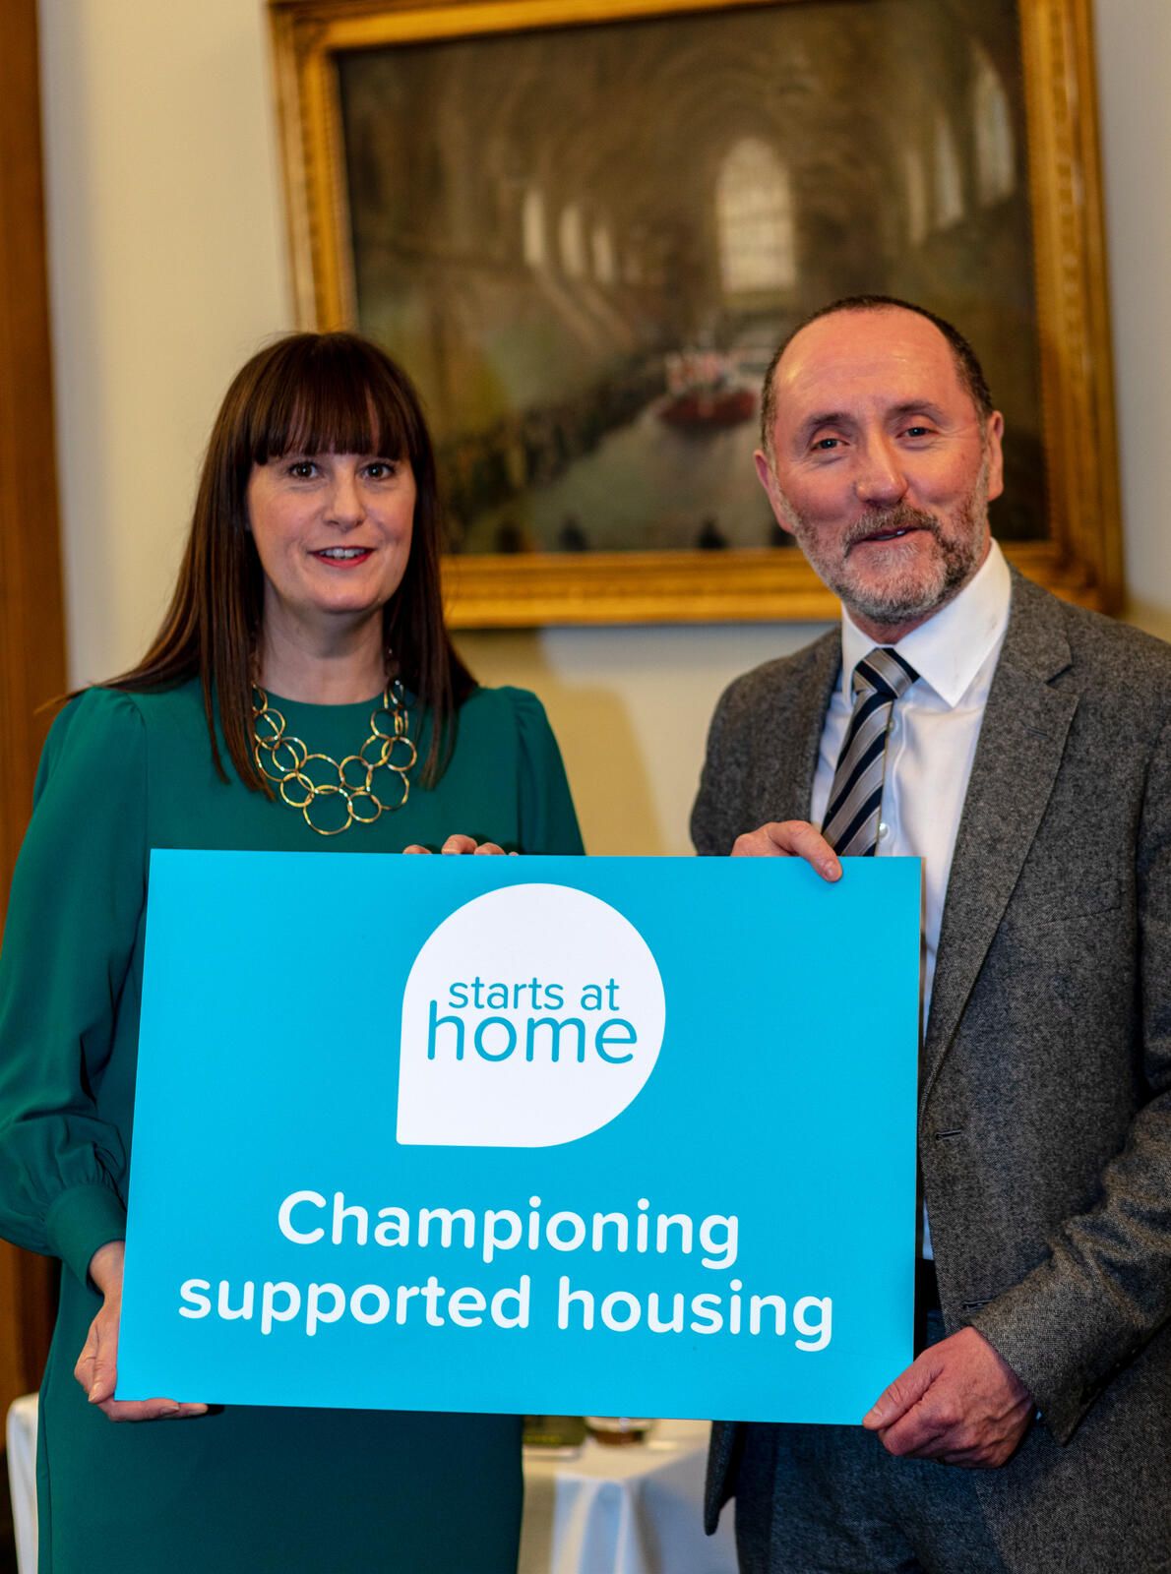
What is this research?
Carried out by Imogen Blood and Associates and the University of York, it focuses on the link between:
  Supported housing.
  Preventing homelessness.
  Promoting positive health and wellbeing outcomes.
Snapshot survey of 2,119 individuals in supported housing. Carried out by their key worker across 11 housing associations.
Qualitative interviews with staff from the NHF, HACT and Homeless Link.

Slide 4
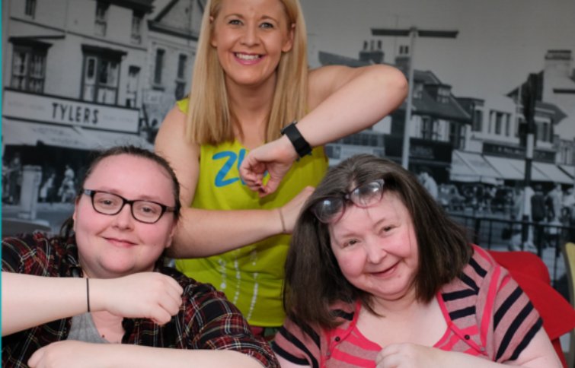
Why commission this research?
Members carry out important work in providing secure supported housing.
There is sometimes a lack of recognition or understanding of this work.
An opportunity to profile individuals who access supported housing.
Demonstrating the key role supported housing plays in preventing homelessness and relieving social care pressures.
Demonstrates the importance of partnership working.

Slide 5
Key findings
Good quality supported housing has a significant positive impact on its residents’ health, wellbeing and sense of social connection.
Supported housing plays a critical role in reducing homelessness and relieving pressures on the social care, health, criminal justice and housing sectors - ultimately lessening demands on the public purse.
Were it not for supported housing, there would be an increase in core homelessness of around 41,000 people, with a further 30,000 people at significant risk of future homelessness.
One of the biggest challenges facing supported housing is the reduction in funding over time. There is a clear need to ring-fence and increase long-term revenue funding for housing-related support to local authorities.
The ability to move people on from supported housing into independent tenancies is limited by a lack of affordable and suitable housing.

Slide 6
Key statistics
If supported housing didn’t exist there would be 41,000 people at risk of rough sleeping and 30,000 more at risk of repeat homelessness; 2,000 more people in prison and 14,000 more people accessing psychiatric care.
Supported housing residents have complex needs: 9 out of 10 have at least one health condition or disability, and half of them are experiencing more than one of these conditions.
1 in 4 residents have a physical disability and/or limiting long-term health condition.
56% of those in transitional supported housing felt ready to move on at time of interview.
Of these, 53% were unable to do so because ‘finding a suitable move-on option is proving difficult.’

Slide 7
Our key asks of government
Ring-fence and increase long-term revenue funding for housing-related support to ensure spending at least matches the £1.6bn per year allocated to local authorities in England in 2010.
Invest in social housing to improve the short-term supported housing sector’s ability to move people to affordable and suitable independent tenancies.
Support effective partnership working between supported housing, the NHS and social care through greater security of funding.
Foster better coordination between criminal justice services and supported housing.
Gather better data about the needs of people living in supported housing and the impact this has on their health and wellbeing, and on the public purse.

Slide 8
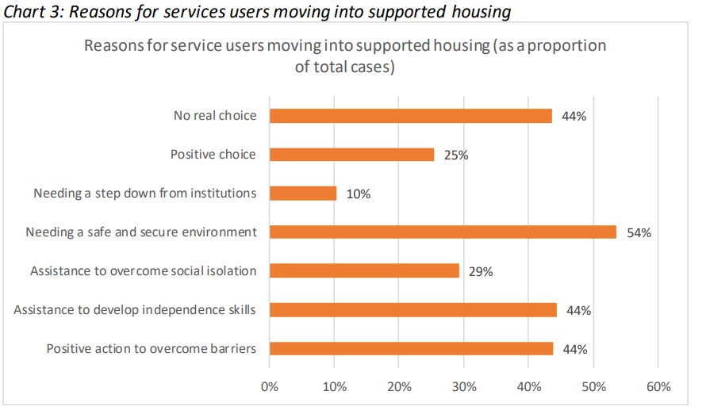
Why do people move into supported accommodation?
These categories have been designated by the service user’s key worker.
Individual pathways into supported housing vary a large amount.
84% of service users had at least five identified needs for assistance, with the average being higher at 9.6.

Slide 9
Profile of supported housing residents
Protected characteristics
Age: those in the 40-64 age group consistently form the majority of residents (41%)
Gender identity: the proportion of men is greater than that of women (68%)
Ethnicity: 18% identified as being from a black or minority ethnic background. This rises to 36% in mental health specialist schemes, 23% in domestic abuse services, and 21% in young person provision.
Mental Health: 56% were identified as having a diagnosed mental health condition. Only 25% of those with diagnosed mental health conditions were living in specialist mental health provision.
Physical health & disability: 12% had a physical or sensory impairment.

Slide 10
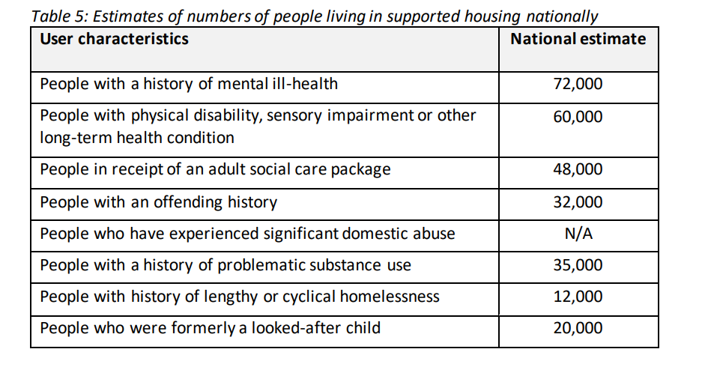
Profile of supported housing residents
Support needs
As the table on the left demonstrates, many supported housing residents present with complex support needs many of which co-exist.
Supported housing provides a safe environment with highly skilled staff to ensure service users receive the support they need.
Notes:
Adult social care:
22% of the total sample have a social care package, though the majority of these are in specialist learning disability schemes (where 91% of residents have a social care package) and mental health schemes (where 33% do).
19% of residents of young people’s services and 9% of generic homeless service users also have a social care package in place.
Offending:
45% of the survey sample had some offending history, according to their keyworker. These were split fairly evenly between our three categories:
• 12% had been convicted of less serious or petty offences in the past but on a one-off or occasional basis
• 15% had been convicted of a series of less serious or petty offences only
• 16% had been convicted of at least one serious offence involving violence, sexual assault, drug dealing, grooming or trafficking.
Rates of offending varied considerably across different client group sectors, with relatively low rates of conviction in learning disability (7% in total), domestic abuse (18%) and young people’s (23%) services, rising to 71% in specialist substance misuse services.
Domestic abuse:
500 people, or 26% of our total sample were known to have some recent experience of domestic abuse .
194 of these people have a domestic abuse experience which was described as “regular and recent/current”, which amounts to 10% of the survey sample.
The incidence of domestic abuse doubles where we look only at the women in our sample. (51% had some recent experience; 21% had experienced ‘regular and recent/current’ abuse).
It is clear from the findings that it is not just specialist domestic abuse services that are supporting survivors (See table in appendix). 61% of women in generic homelessness provision (much of which is likely to be mixed) are recent survivors of domestic abuse; this includes 31% (73 women) who were described as experiencing regular recent/ current abuse. It is striking that 78% of this group of 73 women have either a diagnosed mental health condition, substance misuse problem or both, since these are frequent barriers to accessing specialist refuge provision.
Substance abuse
40% of the total sample (811 people) have a history of problematic substance use, rising to 50% of those living in generic homelessness provision.
Long-term homelessness
303 individuals – or 15% of the total sample were described as having a “history of lengthy or cyclical homelessness”.
Care experience
16% of the total sample has experience of local authority care. Unsurprisingly, the rate is highest in specialist young people’s services, where 24% had been a looked after child prior to the point of moving in, and a further 13% had formerly been a looked-after child.

Slide 11
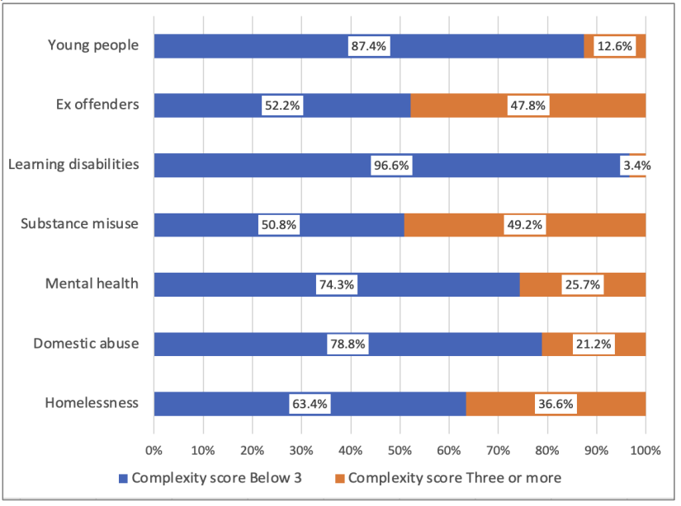
Profile of supported housing residents
Complexity of support needs
Workers felt that 60% of the sample are ‘vulnerable to exploitation or abuse from others’, with 18% felt to be highly vulnerable.
29% of the sample were felt to pose a risk of harm to others, 5% significantly.
This produces a national estimate of 25,000 users who are vulnerable to exploitation or abuse, 4,500 may be considered to pose a risk of harm to other.
The research designates a ‘multiple disadvantaged score’ using several variables. This is marked between zero and five.
29% of the sample scored three or above.
Those over the age of 40 were more likely to score three and above (36% compared to 25%).
Notes:
Multiple disadvantaged score is worked out using:
• Diagnosed mental illness
• History of problematic substance use
• Experience of domestic abuse
• History of offending
• Recurrent or sustained history of homelessness
Other multiple disadvantaged score bits worth highlighting:
No link between gender identity and a higher score
People with higher scores were no more likely to be living in a supported housing scheme offering 24/7 cover.
37% of those living in supported housing for those experiencing homelessness had a score of 3 and over, compared to 22% in schemes for other client groups.
There was an association between homelessness and multiple disadvantage; 75% of those with long term or current homelessness had a multiple disadvantage score of 3 or more, compared to 22% of others in the sample.
Those with higher multiple disadvantage scores were less likely to be felt to be ready to move on from transitional housing (47%), compared to those with lower scores (63%)

Slide 12
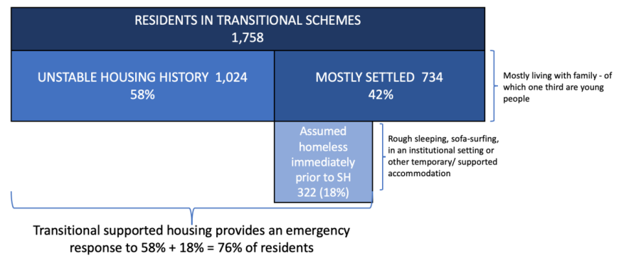
Impact of supported housing on homelessness
Crisis prevention and emergency response
Transitional accommodation provides an emergency response to homelessness for 76% of residents.
The remaining 24% have arguably received ‘crisis prevention’.
This reduces risks to health and wellbeing.
Supported accommodation offers better security than alternatives such as B&Bs.
Notes:
Definitions of type of homelessness intervention:
• Crisis prevention: as a response to relationship, family or tenancy breakdown, to prevent higher risk forms of homelessness such as rough sleeping, before alternative accommodation can be secured.
• Emergency response: housing those who are already homeless, including but not limited to rough sleepers
• Repeat prevention: supporting people into sustainable tenancies or suitable longerterm accommodation to meet their needs.

Slide 13
Impact of supported housing on homelessness
Repeat prevention
Supported accommodation can help service-users access secure tenancies, as well as understand their housing options.
Overall, 56% of service users were deemed ready to move onto settled accommodation.
However 53% of those ready to move on were not able to do so because “finding a suitable move on option is proving difficult”
Effective local authority housing partnerships were reported for just 27% of clients.
There are also barriers related to affordability of housing, financial means and behavioural concerns.
Notes:
Staff judgement is that 51% of those who had been resident in the scheme for 6 months or less are ready to move into settled housing. This increases such that 66% of those who have been in the scheme for 12 months or less are ready to move on. After 2 years of residence, the proportion of people ready to move on declines.

Slide 14
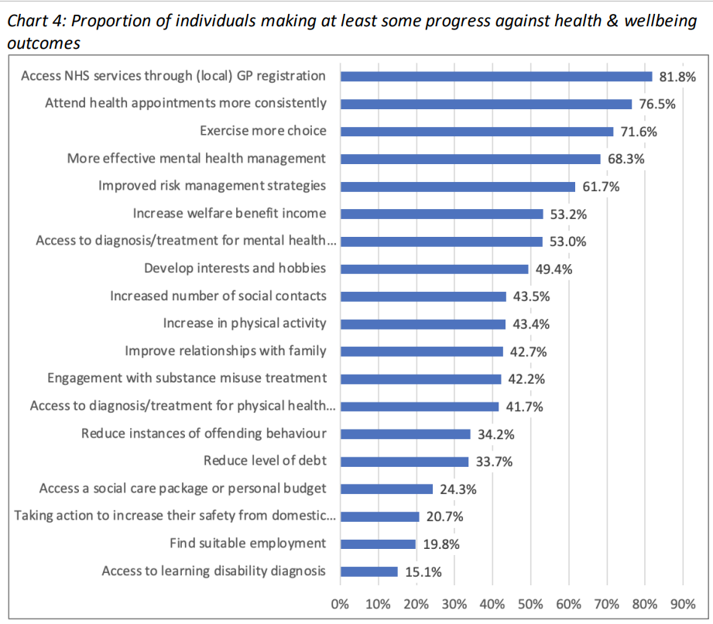
Impact of supported housing on health and wellbeing
The study takes a wide view of ‘health and wellbeing’, including social inclusion, meaningful activities, psychological wellbeing and self-determination.
Supported housing, including longer-term projects, can help with health outcomes, particularly around access of NHS services.
This can free resources and cash for the NHS, reducing pressures.
Notes:
89% of the sample had any one of:
A form of disability
A mental health condition
Learning disability
Substance misuse history
Long-term health conditions
diagnosed autism or Aspergers

Slide 15
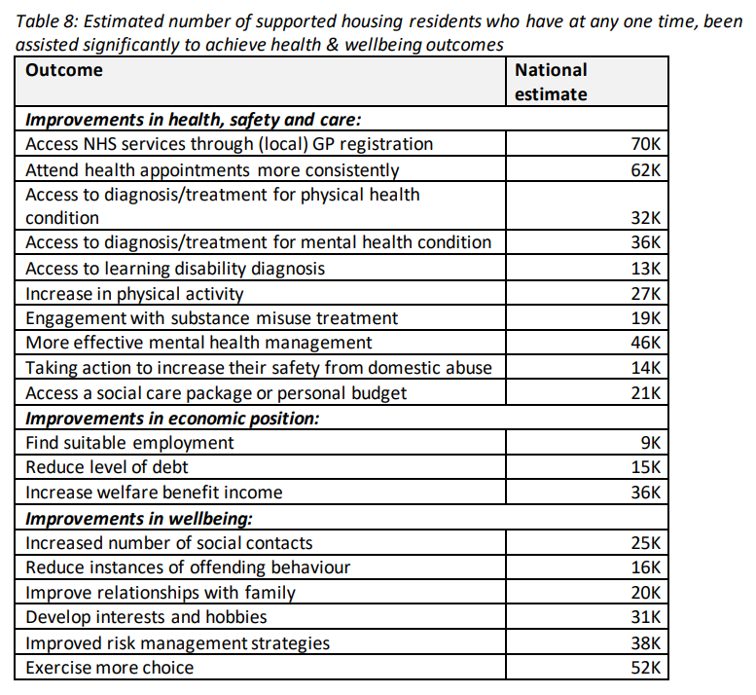
Impact of supported housing on health and wellbeing
The research suggests that supported housing has the greatest impact on the safety, health and social care of an individual.
Those with longer term stays (of a year or longer) reported higher scores than those who’d be in accommodation for a shorter term.
Specialist schemes generally perform better at their intended functions. For instance, generic homelessness services reported better success with accessing specialist substance misuse treatments.
Notes:
May wish to speak about other information here (see page 35 of report). This breaks down success by tenure type.

Slide 16
Understanding the role of housing associations
Qualitative interviews identified that there was limited understanding in the function of supported housing in assisting with health and social care outcomes. The key areas identified by the research are:
Meeting basic needs, such as providing food, warmth and facilities.
Offering personalised support through tailored support plans.
Informal emotional support, often 24 hours a day.
Ad hoc practical support such as assisting with paying bills and attending appointments.
Wellbeing activities. Many providers run schemes such as art and cooking classes.
Help to access other agencies.
Offering independence and choice.

Slide 17
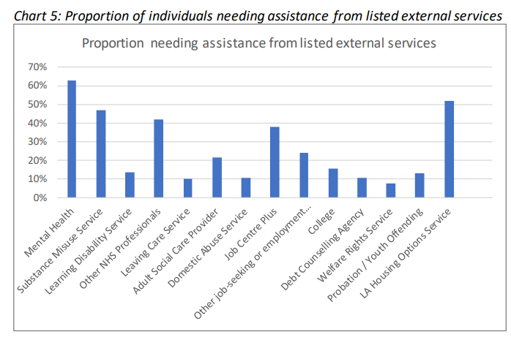
Partnership working
The report identified a clear need for partnership working, particularly around mental health and housing options services.
Supported housing providers are community anchors which help link health and social care services.
Many supported housing services are highly specialised, requiring substantial skills and expertise to meet the needs of complex individual cases.

Slide 18
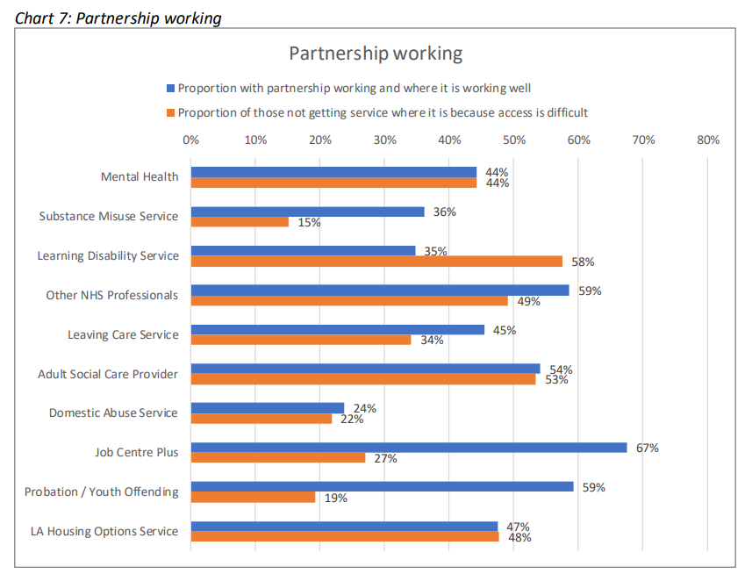
Partnership working
However, this can be problematic, particularly around access. This may be because a client does not wish to engage or due to limited availability.
Those with lower disadvantage scores generally had better access than those with higher.
There was a great deal of variation across schemes and areas.

Slide 19
Barriers to partnership working
There may be a lack of understanding of housing across Integrated Care Boards. It is key that ICBs have specialist housing staff involved.
Increased dialogue between clinicians and housing providers would be helpful. This should take place alongside the formulation of longer-term strategies.
Depleted local authority funding and resourcing can lead to a limited appetite for commissioning of housing services.
There may be limited existing relations between services and housing providers. Trust and relationship building are a key area of commissioning.
Language used by housing providers should mirror that of the NHS, such as that around ‘freeing bed-space’.

Slide 20
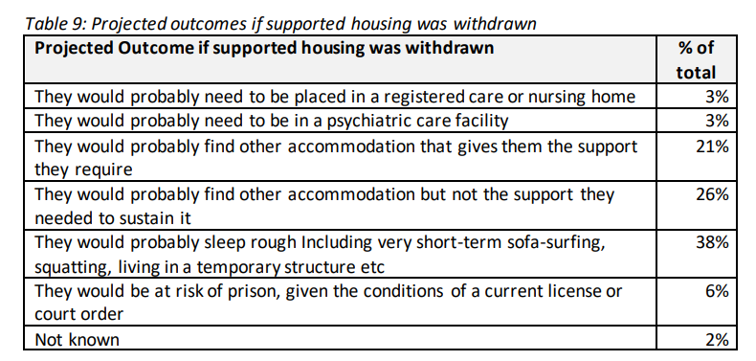
Value for money for other services
The average cost per year of a supported housing place is £21,000.
We may wish to compare this to the average cost for homeless people outside of support, £34,500.
The report advises that typically, these arguments may not convince local statutory bodies, as they are under great pressures and are unlikely to directly benefit in the short-term.

Slide 21
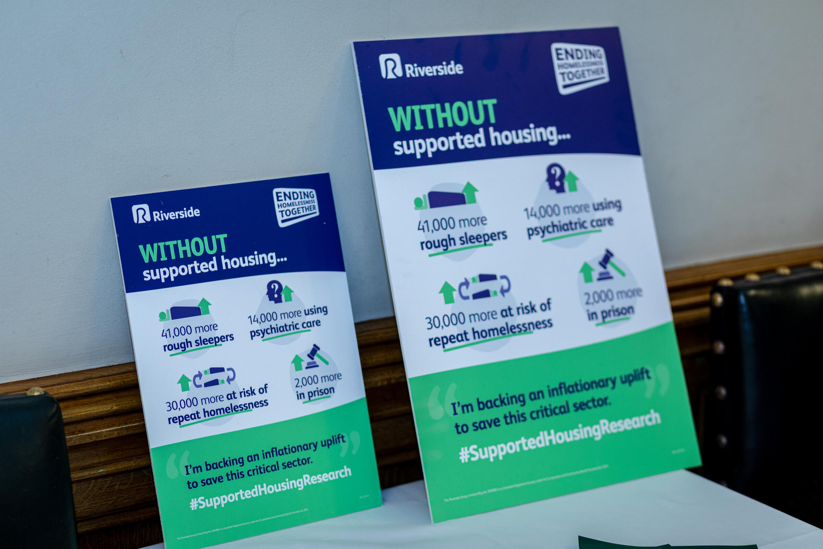
The impact so far…
On 9 March 2023, we launched this research in Parliament in an event sponsored by Eddie Hughes MP.
We have launched a lobbying research for members to use when speaking with their MPs and local commissioners.
We encourage members to read this report and share with their networks.
We have had engagement with the Department for Health and Social Care as well as wider government.
On 30 March, there was a Lords debate based on the research’s findings led by Baroness Diana Warwick.

Slide 22
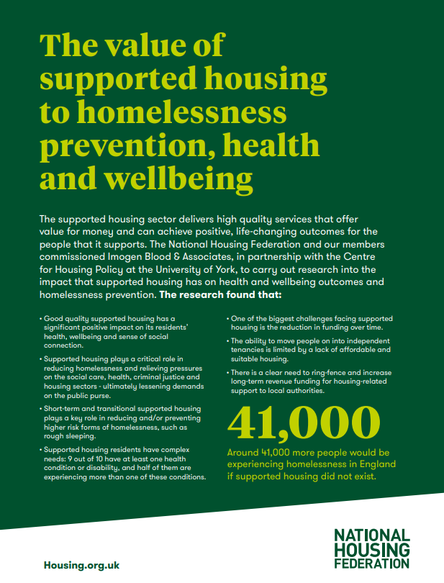
What can members do?
Share the research and plan meetings and visits with local politicians and stakeholders based on the research findings (the NHF can help with this).
Work in partnership with local authorities to help plan supported housing to meet local need.
Work with local authorities to help plan general needs housing for move-on from supported housing.
Take an active part in local ICS systems to help the NHS understand the role of supported housing in improving health outcomes.
Provide data on resident need to aid the development of local plans and underpin partnership working.
Take part in Starts at Home Day 2023.

Slide 23
For any questions, please speak with:
Sue.Ramsden@housing.org.uk
Dean.McGlynn@housing.org.uk
Or visit: www.housing.org.uk/our-work/supported-housing/

